Slide 1

Quine-Mc’Clusky’s and Moisil’s simplification methods

Slide 2
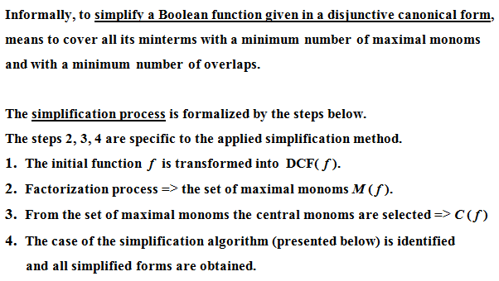
Simplification of Boolean Functions

Slide 3
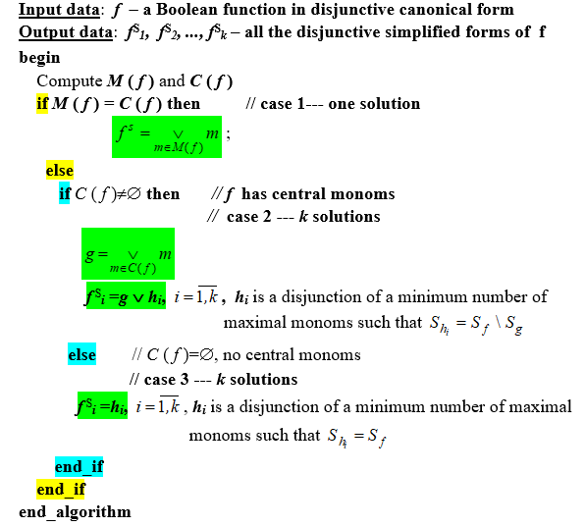
Simplification Algorithm

Slide 4
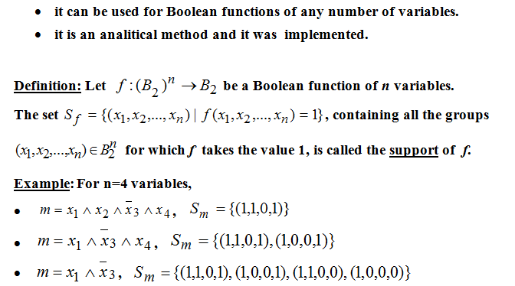
Quine’s method

Slide 5
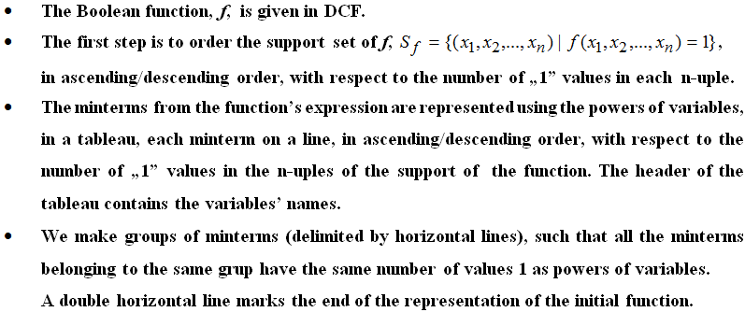
Quine’s Method –description (I)

Slide 6
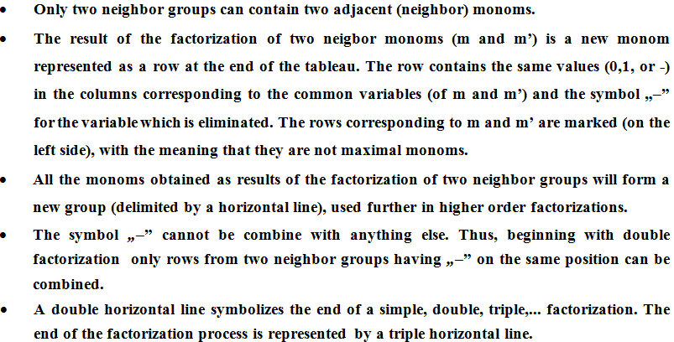
Quine’s Method –description (II)

Slide 7
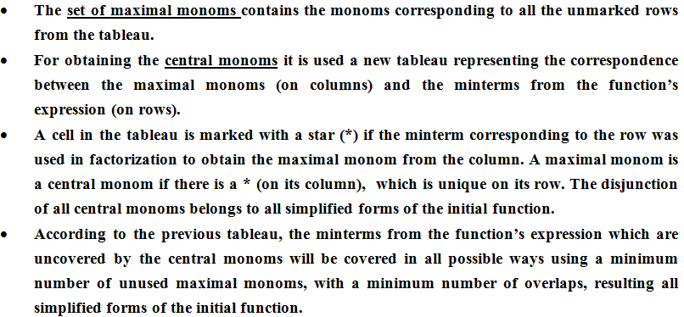
Quine’s Method –description (III)

Slide 8
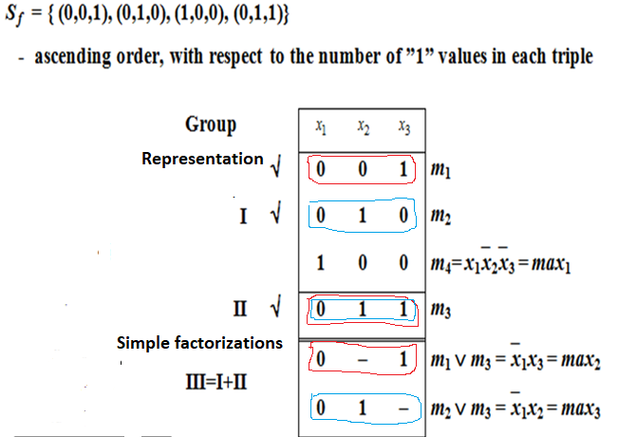
Example 1. Simplify the Boolean Function
- support set of f
Maximal monoms

Slide 9
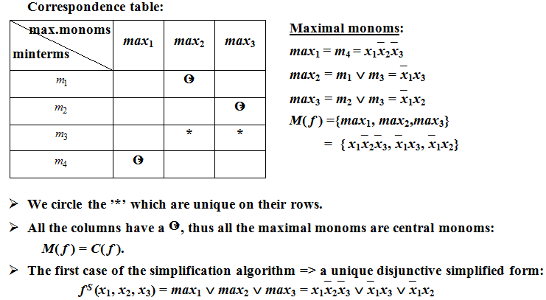
Example 1 (contd.)

Slide 10
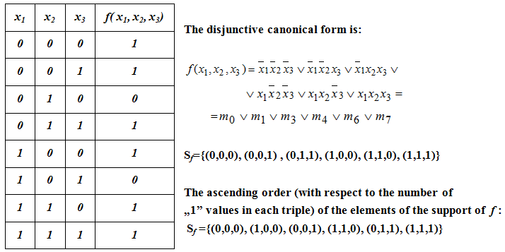
Example 2. Simplify the Boolean Function

Slide 11
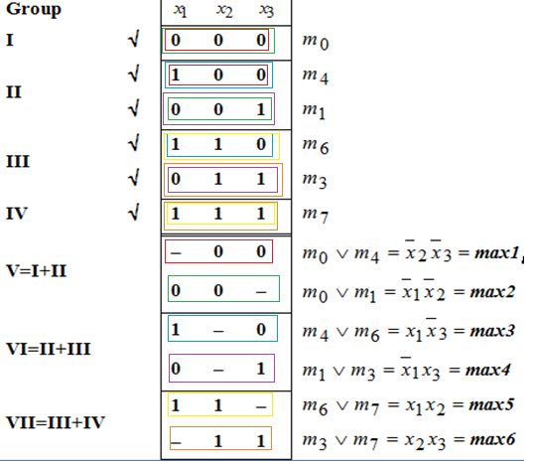
Example 2 – Factorization process
- the support set of the function
Representation
Simple factorizations
Maximal monoms

Slide 12


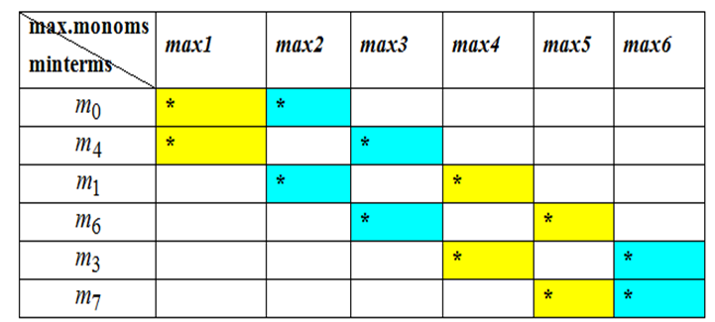

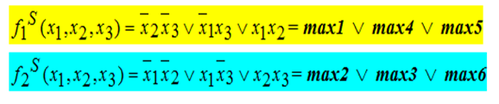
Example 2 (contd.)
Factorizartions:
Correspondence table:

Slide 13
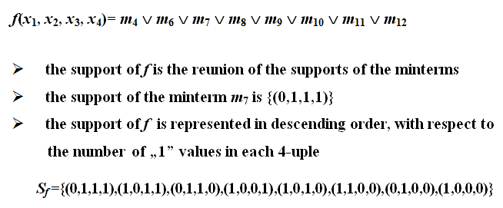
Example 3. Simplify the Boolean Function

Slide 14
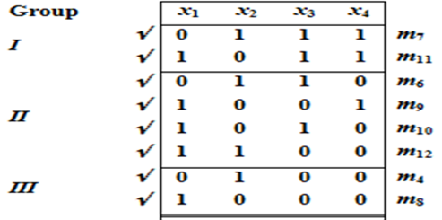
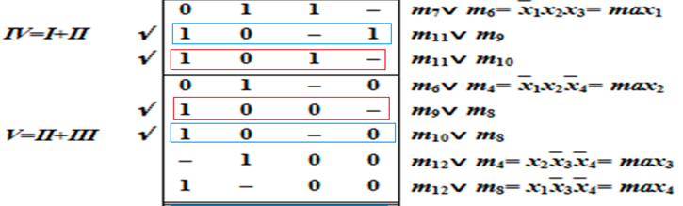
Example 3 - Factorization Process – maximal monoms
Support set of f
Representation
Simple factorizations
Double factorizations
-maximal monoms

Slide 15
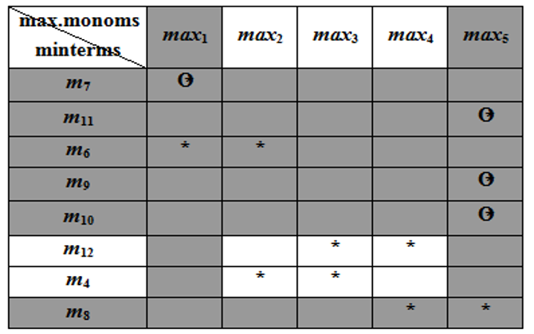
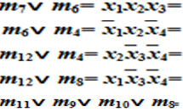


Example 3 – Central monoms
Correspondence table:
Factorizartions:

Slide 16
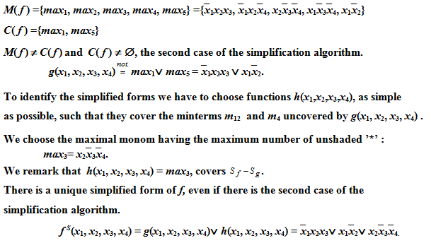
Example 3 – simplified forms
- maximal monoms
- central monoms

Slide 17
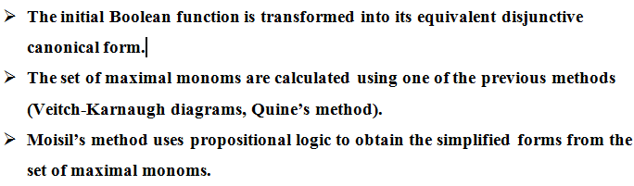
Moisil’s simplification method

Slide 18
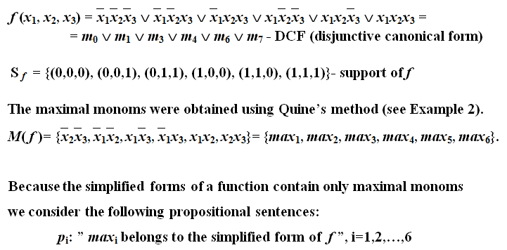
Example 4. Simplify the Boolean Function

Slide 19

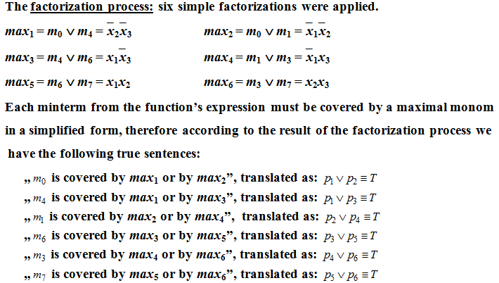
Example 4 (contd.)

Slide 20
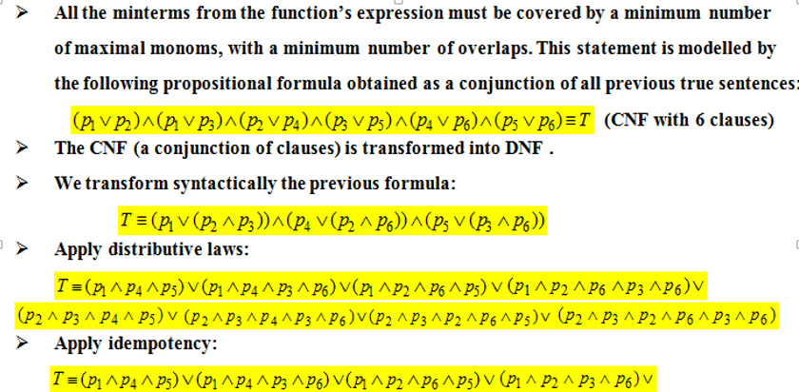


Example 4 (contd.)

Slide 21
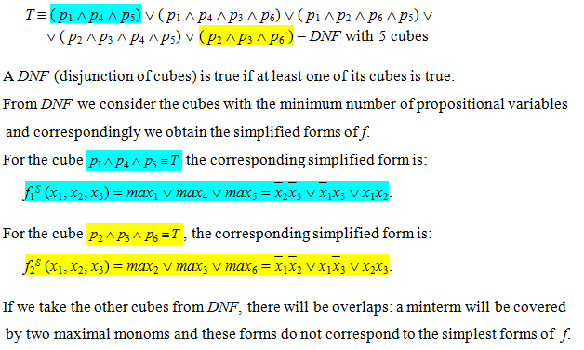
Example 4 (contd.)

